Slide 1
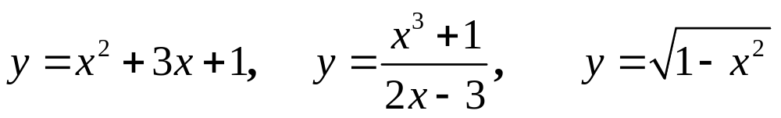
Section 3.7 Implicit differentiation and
related rates
Explicit function: y=f(x)
Implicit function: F(x, y)=0
The equation defines a function y=f(x) such that F(x, f(x))=0,
but in practical problems, you can’t get the explicit form y=f(x)
from the implicit form F(x, y)=0.

Slide 2
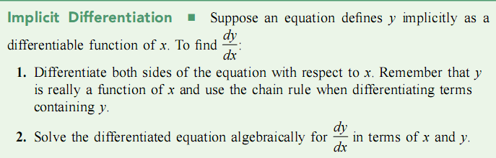

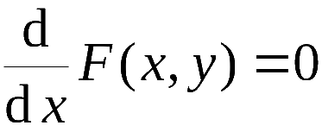
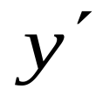
Differentiate both sides
(The equation involving )

Slide 3

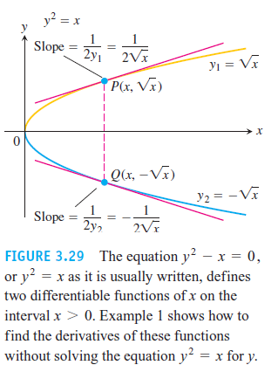
Example 1.

Slide 4
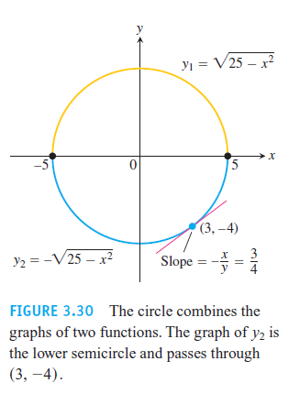


Example 2.

Slide 6
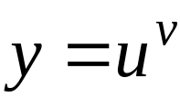

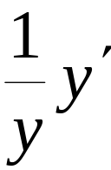
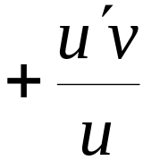

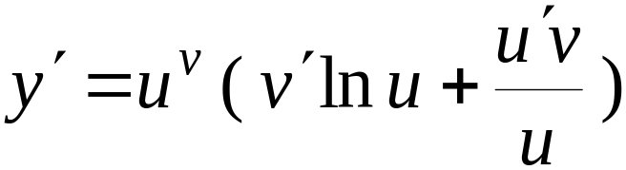
Logarithmic Differentiation
The derivatives of positive functions given by formulas that involve products, quotients, and powers can often be found more quickly if we take the natural logarithm of both sides before differentiating. The process, called logarithmic differentiation
For power-exponential function
We can take the logarithmic function on both sides first, and differentiate implicitly

Slide 7
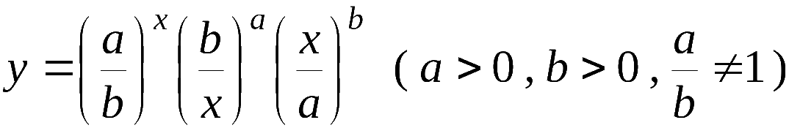
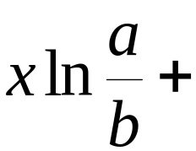



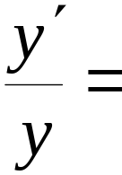
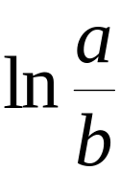
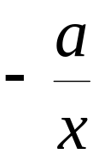
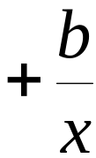
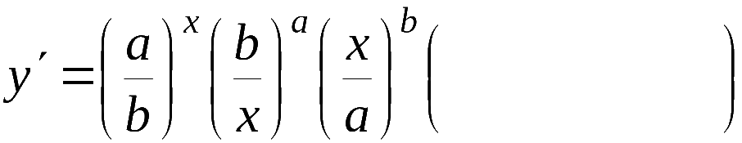
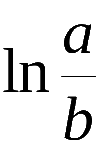


For instance,
take the natural logarithmic function on both sides
Differentiate both sides with respect to x

Slide 8
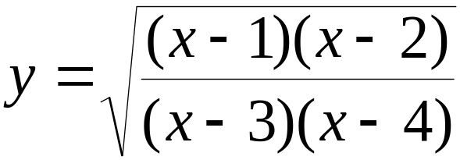
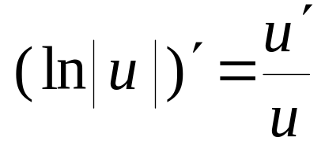
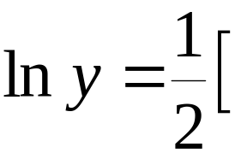


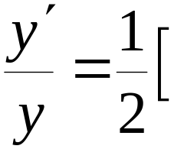
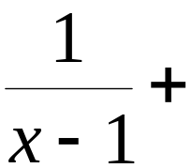
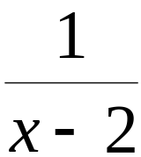
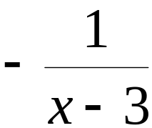
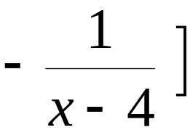
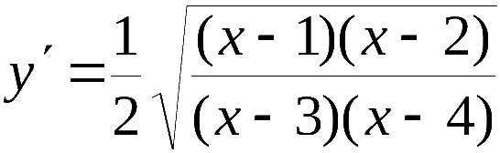
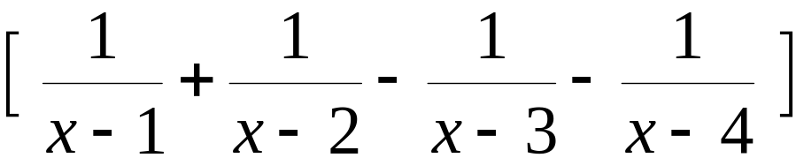
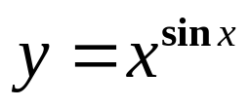
Example :
take the natural logarithmic function
Differentiate both sides with respect to x
Example 5. Find the derivative of

Slide 9
Example 5. Find the derivative of

Slide 10
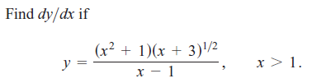
Example 6.

Slide 11


Related rates:
There are two functions x=x(t) and y=y(t) related by
F(x, y)=0,
differentiate both sides of the equation with respect to t,
you will get an equation involving the rates of change
and , this equation is called the related rates equation.

Slide 12
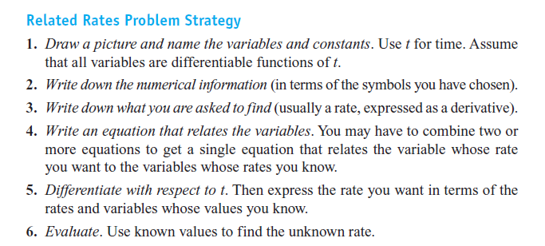

Slide 13
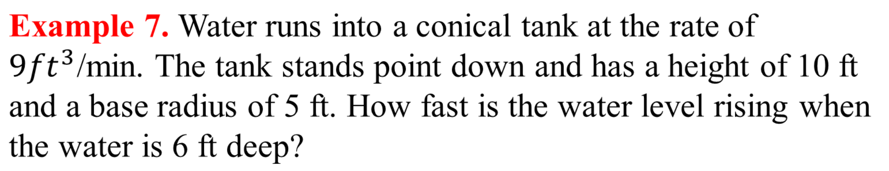
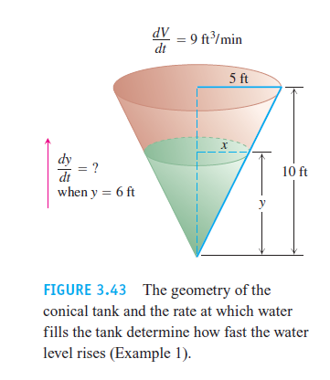

Slide 15
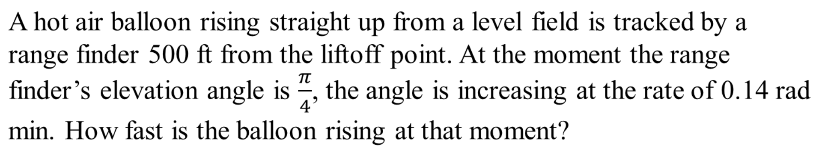
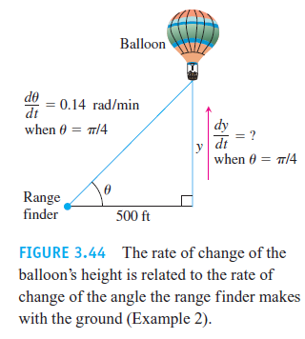
Example 8.

Slide 17
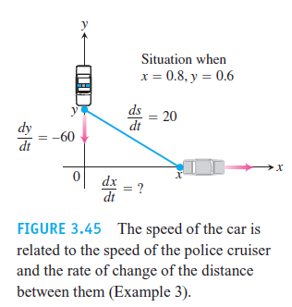
Example 9.
A police cruiser, approaching a right-angled intersection from the north, is chasing a speeding car that has turned the corner and is now moving straight east. When the cruiser is 0.6 mi north of the intersection and the car is 0.8 mi to the east, the police determine with radar that the distance between them and the car is increasing at 20 mph. If the cruiser is moving at 60 mph at the instant of measurement, what is the speed of the car?

Slide 19
Homework: Page 174. 20, 40
Page 199. 25

